Slide 1
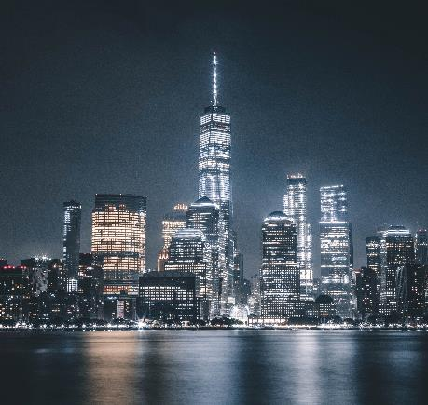
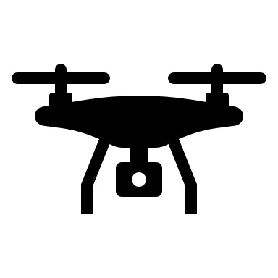


PUBLIC SAFETY & AUTONOMOUS DEVICES
A plan for augmenting law enforcement and improving planned event safety
Team: Guru Ananthaneni, Annabelle Blair, Yannick Forbes, Han Lai, Umesh Mishra
Mentor: Jeff Bartlett
05/03/2023
Notes:
Has Name/Logo, contact information, correct date, acknowledging to whom the plan is being presented, this section should be sharp and uncluttered

Slide 2



Business Proposal
THE PROBLEM
Public Safety & Planned Events
Unmet-Need
76%
Law enforcement agencies struggling to fill off-duty/OT shifts
Shortage of law enforcement to support increased number of public events.
Public event security requires costly OT & is challenging to staff
Need for efficient solution for public event safety for augmenting law enforcement
Sobering Examples
9%
Average Police overtime (OT) spent on special events
Amount spent on OT security staffing for events by mid-sized agency, Austin PD
$684K
Astroworld Crowd Crush
July 4th Highland Park Shooting
33%
Overtime required by Seattle PD to support events
Resignation +18%
&
Retirement +45%
Recruitment
&
Retention
2
Notes:
Annabelle
Many law enforcement departments across the U.S. struggle to provide timely and quality services due to staffing challenges and shortages that reduce response time, limit availability for in-person interventions, and leave communities vulnerable to public safety threats.
Resignation and retirement rates for law enforcement personnel are high (a recent study reported increases of 18% and 45%, respectively), which means large overtime budgets for cities and law enforcement agencies. Overtime wages from an average police officer in the U.S. costs agencies hundreds of thousands of dollars weekly. Reduction of the workforce also stretches existing resources thin, meaning less time spent improving public safety.

Slide 3
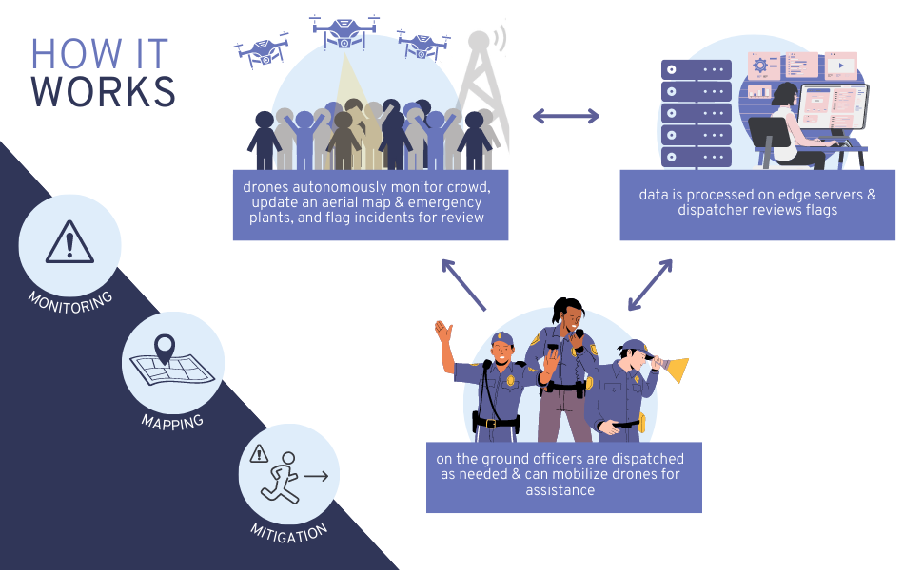
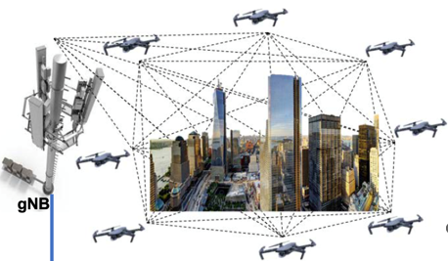
Business Proposal
OUR SOLUTION
Solution
Augment staffing with drone technology
Autonomous 5G enabled Drones providing holistic view of public events.
MEC-based AI/ML engine identifying security threats and providing actionable inputs for crowd management.
3
Notes:
Annabelle
This thing is going to make your life better
Money is the midway point:
Our business plan presents a solution that will enhance crowd management and public security at planned events, providing greater situational awareness and saving law enforcement agencies up to 20% per year in OT costs. AB adjusts
Present your solution, talk about how you can keep others from duplicating it, patents and intellectual property come into play, project a strong first mover advantage
How is your solution creating Value for Customer? AT&T?
Wholesaler (pipe provider) Vs. e-to-e solution provider with partners
Which solutions and why, and in what order (in time)
Can you discuss that value quantitatively/qualitatively?
Our business plan presents a solution for these issues, saving customers 17-20% per year in OT costs. We will augment staffing at large, planned events, leveraging AT&T’s 5G network and FirstNet and MEC capabilities, and integrating AT&T’s 5G network with smart, autonomous drones. This will not only help law enforcement agencies reduce overtime costs, but also alleviate a staffing shortage, leading to enhanced public safety and improved situational awareness for the officers on the ground.

Slide 4
Business Proposal
VALUE PROPOSITION
Saving Customer Dollars
20%
Savings on OT spending for special event security
Value Proposition
Augment law enforcement to support public events, reducing OT hours & saving costs
Provide improved situation awareness & public safety with early threat alert
Offers easy solution for timely crowd management insights
Responds to current law enforcement agency interest in drones – 47% currently use drones & 34% want to purchase
$118K
Customer savings per year vs. the present mode of operation (PMO)
TODAY’S COST
 | Helicopter Operations | Police Patrolling
Hourly Rate | $800 | $43.27
Avg. Hours | 20.5/mo | 4 officers x 22/wk
PMO Cost Per Year | $196,800 | $198,000
PMO 3-Year Cost | $590,400 | $594,000
Our Solution Cost Per Year | $78,600 (initial cost $318,600)
Our Solution 3-Year Cost | $475,800
Average Agency 3 YR savings | $118K x3 = $354K
Why AT&T?
AT&T is uniquely positioned with its strong first responder customer base, one-of-a-kind FirstNet program & competitive 5G and network offerings.
4
Notes:
AB/Umesh
Add 5G and why AT&T should get involved.

Slide 5
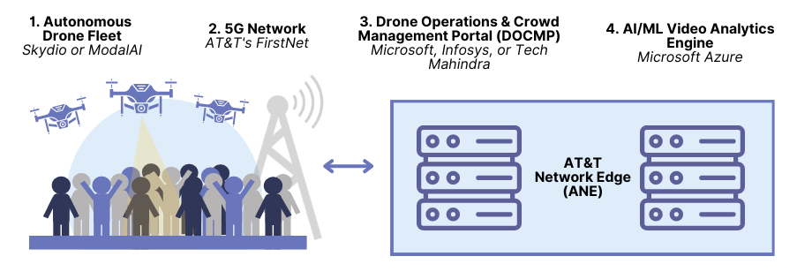
Business Proposal
TECHNOLOGY & IP
Autonomous
5G Capable
BVLOS support
High BW
Low Latency
Priority for First Responders
Deployable assets for extended capacity & coverage
Software App launching autonomous drone fleets
Visualization for Crowd Management
IP opportunity
Analyze drone video & sensor feed for public safety threats
Provide actionable insights for crowd management
Drones
5G & FirstNet
DOCMP
(Edge/ANE)
AI/ML
(Edge/ANE)
5
Notes:
Umesh
Optional but you may talk about the technology or unusual aspects of your product, intellectual property issues can also be covered

Slide 6
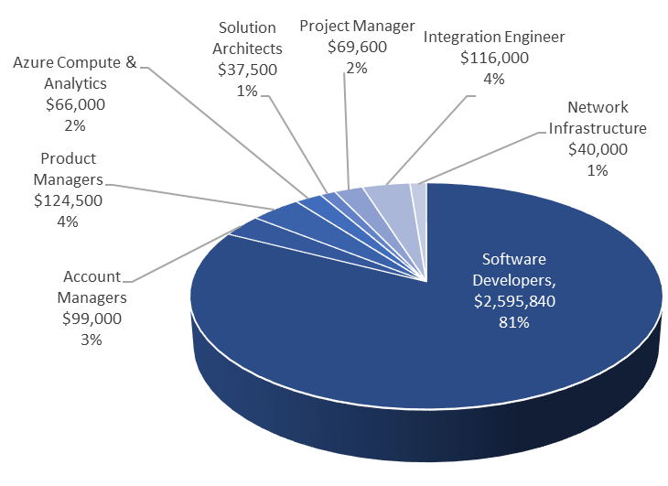
Business Proposal
DEVELOPMENT & OPERATIONS
DEVELOPMENT COSTS
OPERATIONS COSTS
$3.2M
Y1 $1.35M Y5 $2.67M
OPERATIONS
COST BREAKDOWN
6
Notes:
Umesh
Specify how much financing you are seeking and how would you use it in future
an overview of operations plan

Slide 7
Business Proposal
OPPORTUNITY & SALES MARKET
AGENCIES TARGETED PER YEAR
average of 8 drones per agency
PROJECTED SALES VALUE
Solution
Total Addressable Market
18K agencies
Largest Agencies 5
Mid-Sized Agencies 20-25
Large & Mid-Sized 15
$11.8M
Y1
$8.8M
Y2
$7.2M
$4.7M
Y3-Y5
$1.7M
TAM in Dollars
$4.32B
Revenue by Y5
$11.8M
7
Notes:
Han
So why is this investment worth it?
With 18,000 police agencies with an on average need of 8 drones per agency, the estimated TAM in dollars is $4.32B
Our approach will be to target 5 agencies in Y1 – focusing on the largest agencies which will need more than 8 drones – and scaling up year by year
We project by Y5 we will make $11.8M in revenue – with majority of revenue coming from drone sales in early years, but drone sales and 5G revenue contributions are almost equal in later years
Key Takeaway: There is a large TAM to target and, even with conservative estimates, we make a healthy amount of revenue that scales year over year as we acquire new agencies. If we want to increase our revenue, there is an opportunity to increase our pricing model (which we will discuss in detail later) in proportion to agency savings and other non-tangible values or expand our product offering and upsell FirstNet products.
Articulate your specific target market with solid support of projected sales. Use graphs. Be ready to defend your numbers
5 > 15 > 20 > 20 > 25

Slide 8
Business Proposal
COMPETITIVE LANDSCAPE
5G for public safety via FirstNet
Large law enforcement customer base
AT&T’s Competitive Advantage
First packaged solution for planned events
PORTER’S FIVE FORCES
Threat of Substitutes MODERATELY HIGH
Threat of New Entrants MODERATELY LOW
Bargaining Power of Buyers HIGH
Intensity of Competition MODERATE
Bargaining Power of Suppliers HIGH
Verizon Frontline
T-Mobile
Drone hardware & attachments
Software development
Designed with and for law enforcement
Funding via public safety grants
Standalone drone software & technology
Motorola Solutions
FAA approval
Large number of barriers to entry
AI surveillance cameras
8
Notes:
Han
So what is the competitive landscape like?
The main threat is substitutes
There’s a lot of standalone drone tech and other AI-based tech like cameras that can be used for similar purposes
Motorola Solutions being the main competitor here
There is one other direction competitor…
Verizon Frontline – they have the means to make an equivalent solution (dedicated network, edge compute service, and drone technology), but focus on the large public disaster use case
New Entrants – T-Mobile lags behind AT&T & Verizon but has the means to make an equivalent solution, their focus is consumer applications however
Lastly, bargaining power of suppliers and buyers is HIGH because we are outsourcing many of the components of our solution + need to work with law enforcement for funding, FAA approval, and software development
AT&T’s main competitive edge here will be take advantage of their large law enforcement customer base, FirstNet, and being the the first packaged solution for planned events (strong first mover advantage)
Lay out your competitive landscape. Show your competitive edge over others

Slide 9
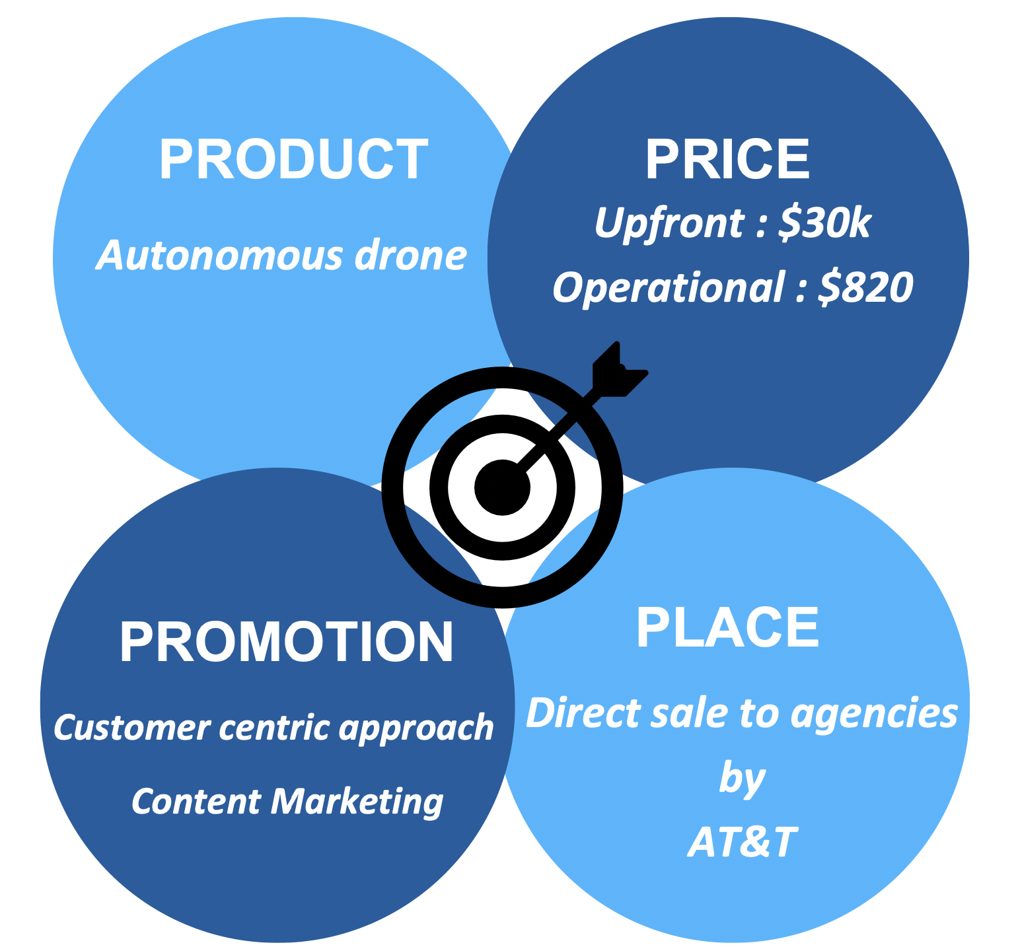
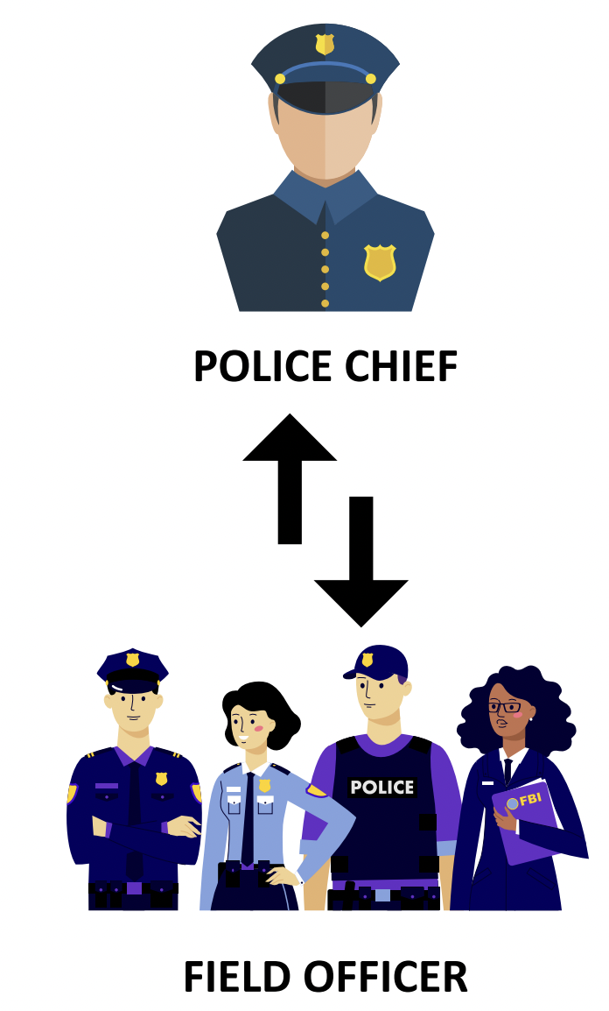
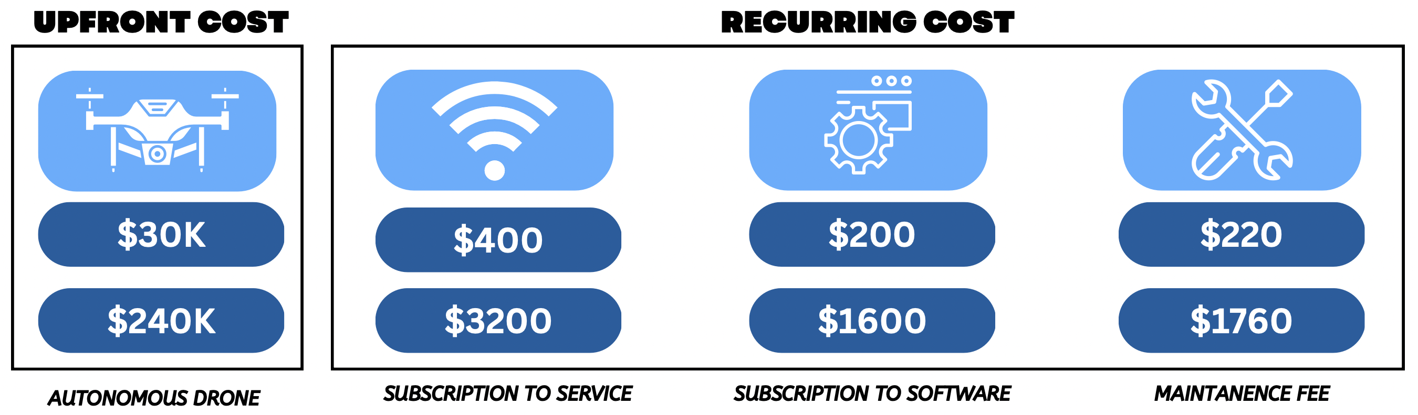
Business Proposal
MARKETING STRATEGY
CUSTOMER CENTRIC APPROACH
Solution
Costs Per Done
Cost for avg agency @ 8 drones
9
Notes:
Guru
Describe the overall marketing strategy, report the research results

Slide 10
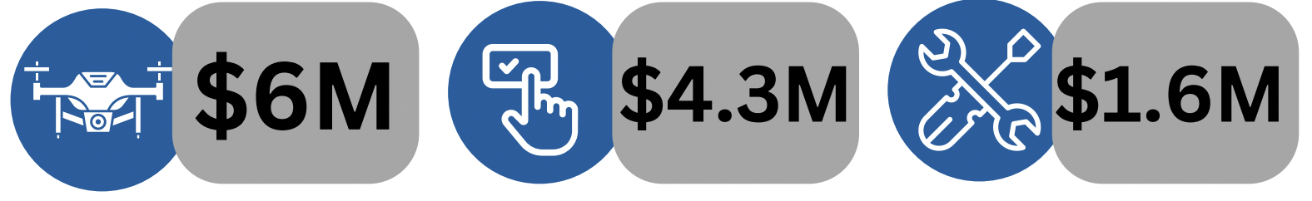
Business Proposal
INCOME & TOTAL REVENUE
Key Takeaways
Solution
Revenues, profits & income see healthy growth YOY.
@ 75% Equipment COGS remains constant
Operating income will take a negative dip in Y1 and takes a positive trend from Y2 till Y5.
Operating expenses increase with agency capture numbers, largely due to increases in engineering, marketing & sales roles.
Revenue Streams
By Year 5
10
Equipment Revenue
Subscription Revenue
Maintenance Revenue
Notes:
Guru
summary of income and cash projections for 3-5 years, explain assumptions considered

Slide 11
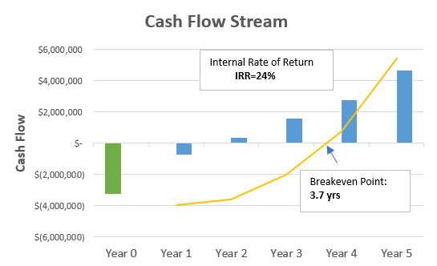
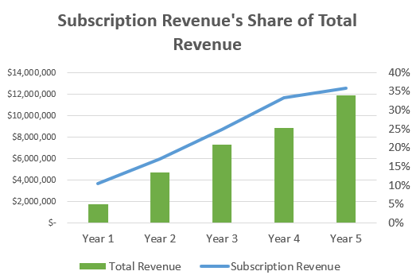
Business Proposal
BREAK-EVEN ANALYSIS & ROI
INITIAL INVESTMENT
BREAK-EVEN
IRR
SUBSCRIPTION REVENUE %
$3.2 MILLION
3.7 YEARS
24%
3X INCREASE
11
Notes:
Guru

Slide 12





Business Proposal
TIMELINE & MILESTONES
Prototype Dev
&
Proof of Concept
Vendor Selection
&
Scope Agreement
Alpha Testing
&
Beta Testing
Network
Integration
Full-Scale Product Launch
2024
1st Half
2024
2nd Half
2025
1st Half
2025
2nd Half
2026
12
Notes:
Yannick
Project the current status of the firm in terms of milestones achieved

Slide 13




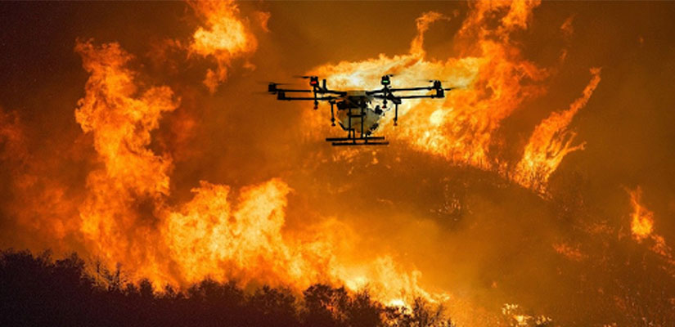
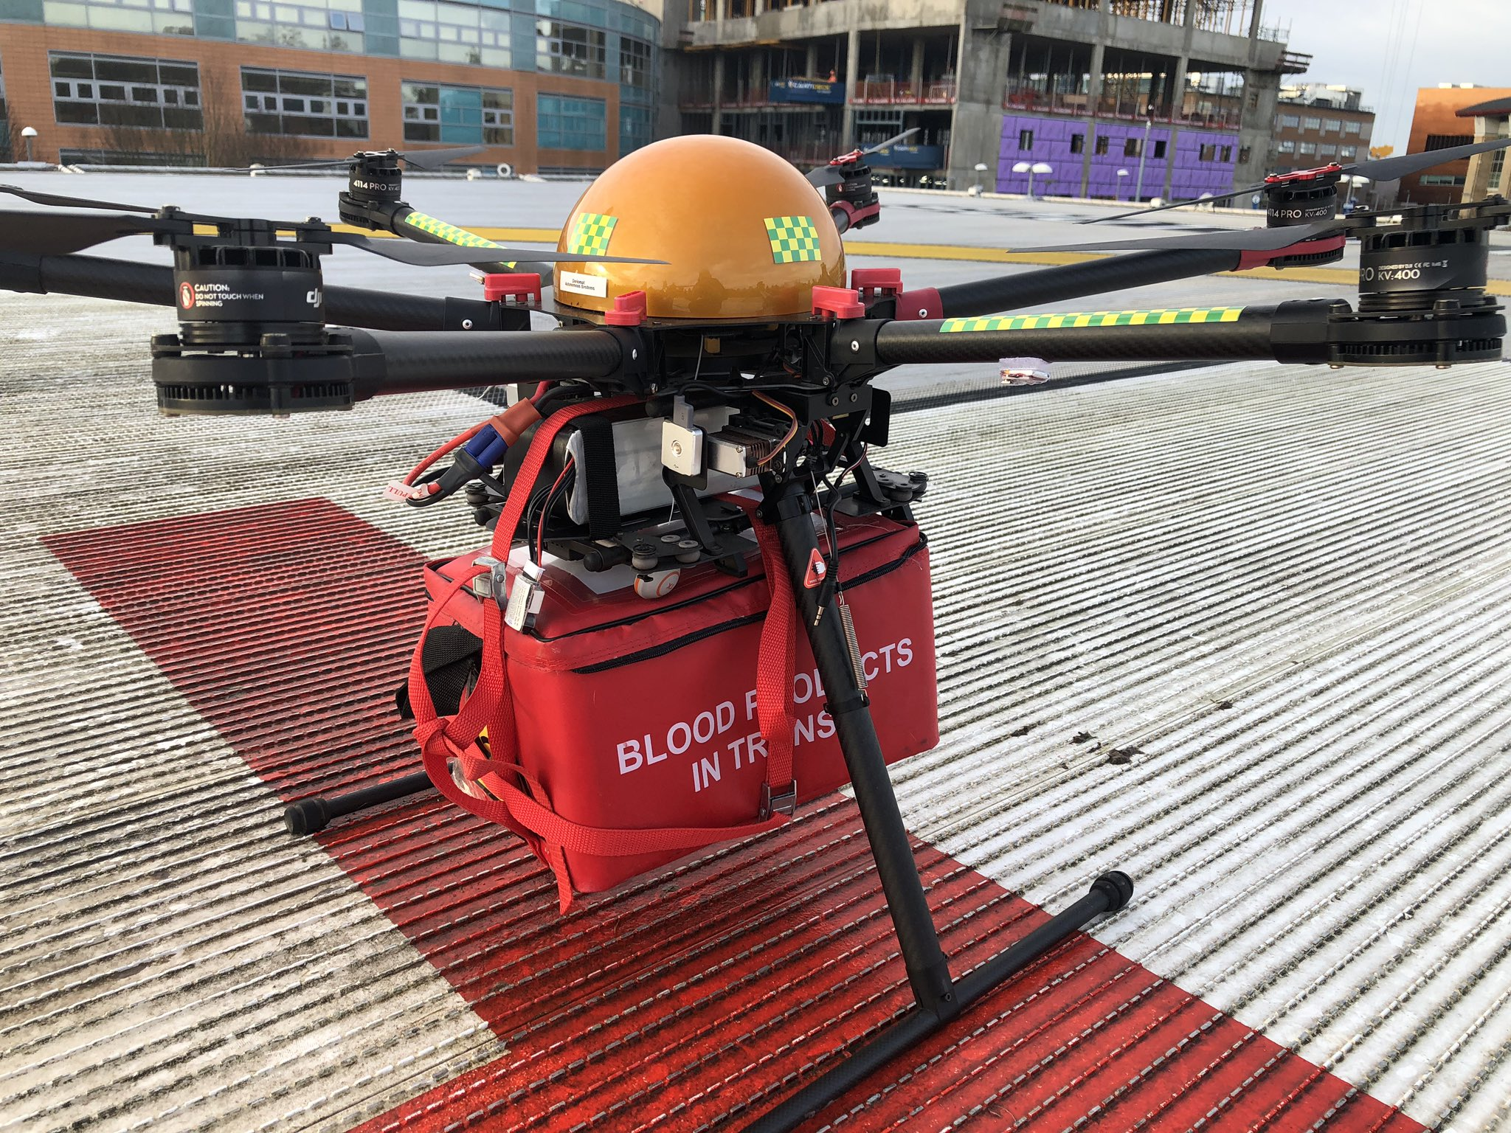
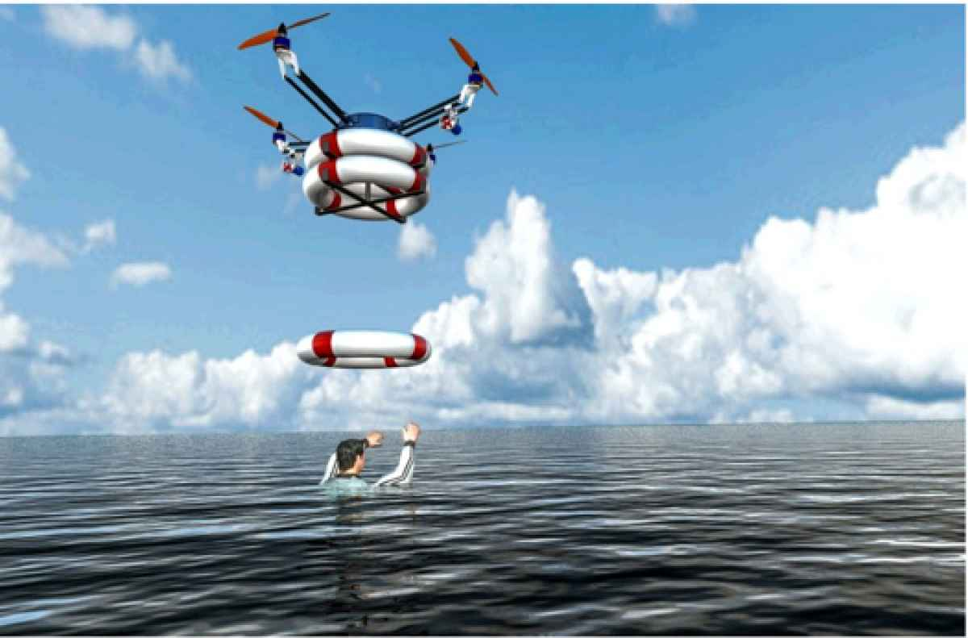
Business Proposal
SUMMARY & GROWTH OPPORTUNITIES
Increase situational awareness and assess/reduce risk to officers
Enhance police presence in the field
Allocate resources in terms of priority
Upsell with accessories & data insights packages
Monitor threats with aerial view
Respond quickly to emergencies
Ease concerns through crowd control and management
Capture images/footage for evidence
13
Notes:
Claims investigation: Insurance companies can use drones to assess damage to properties and vehicles after natural disasters, accidents, or other events.
Risk assessment: Insurance companies can use drones to inspect properties before providing coverage to assess the potential risk of damage or liability.
Litigation support: Law firms can use drones to gather aerial evidence in cases involving property disputes, personal injury claims, or other legal matters.
Increased situational awareness
Why should AT&T decide to get into this Business?
One stop shop – single solution integrator across verticals

Slide 14
APPENDIX A: COST TO CUSTOMER
COST OF PMO
 | Helicopter Operations | Police Patrolling
Hourly Rate | $800 | $43.27
Avg. Hours | 20.5/mo | 4 officers x 22/wk
Total Cost Per Year | $196,800 | $198,000
Y1 Savings w/ Drone Solution | -$121,800 | -$120,600
Y2+ Savings w/ Drone Solution | $118,200 | $119,400
COST OF SOLUTION
Cost of Drone Solution (8 drones)
Drone Equipment | $240,000
Subscription (Software + Service) | $57,600
Maintenance Fee | $21,000
Initial Investment | $318,600
Total Cost Per Year | $78,600
CUMULATIVE SAVINGS W/ SOLUTION
 | Helicopter Operations | Police Patrolling
Y1 | -$121,800 | -$120,600
Y2 | -$3,600 | -$1,200
Y3 | $114,600 | $118,200
Notes:
Appendix

Slide 15


THANK YOU!
Q&A
Business Proposal

